Slide 1
Group Piecework
A Piece rate calculation program designed for teams working together

Slide 2
Main Control Page
Create New work Groups
Hide or show data core
Hide or show History Data worksheet

Slide 3
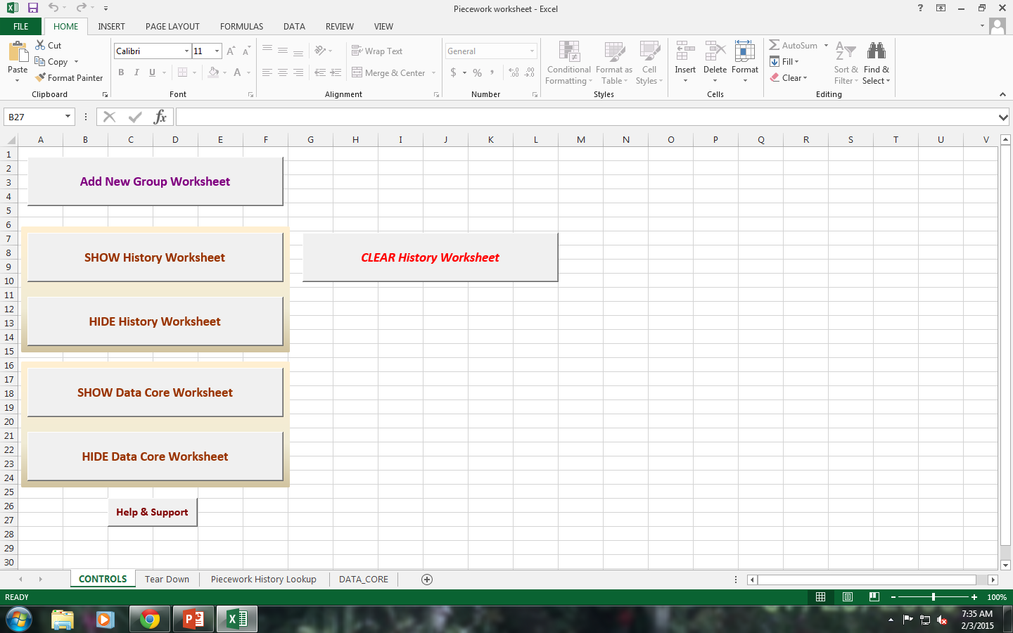
CONTROLS PAGE

Slide 4
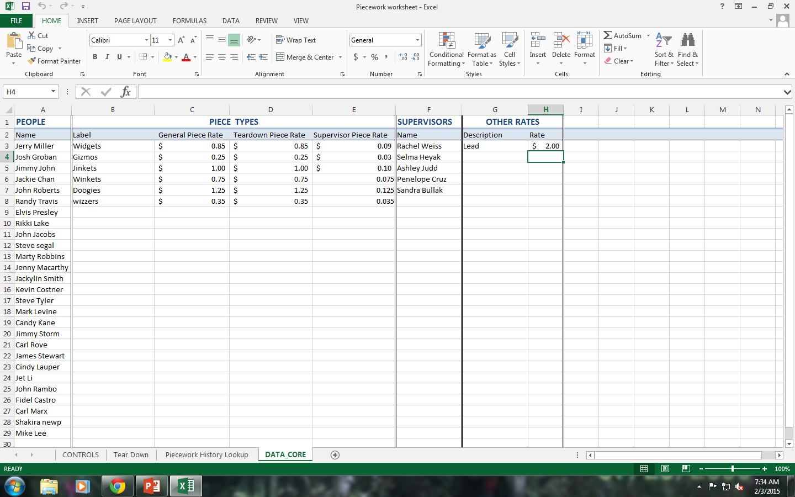
DATA CORE

Slide 5
Data Core
This is where all the initial piecework data is filled in
Employee names
Piecework items
Rates per piece
Teardown rates (this column is for piece rate by individual)
Supervisor piece rate (supervisor can get an hourly rate plus a portion of the group’s payout)
Supervisor Names
Other Rates: These are hourly rates that can be set for individuals within the group; such as a group leader, forklift driver etc.

Slide 6
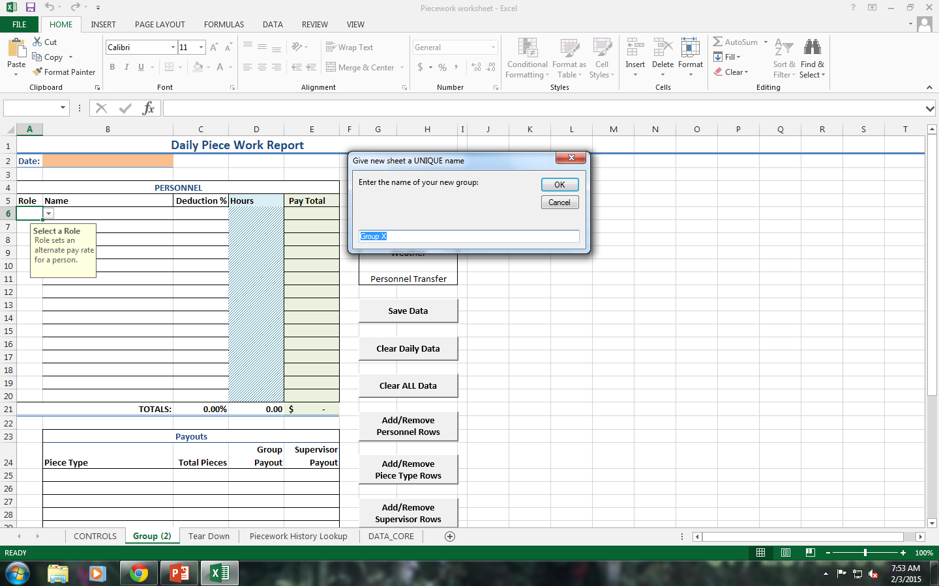
Setting up teams
From Control tab click on ‘add new group worksheet’

Slide 7
Give each Group a Name
A group name is required for each new group
As groups are created a tab for each group is added to the program
Add names of employees for each group from the dropdown list
Add supervisor name for each group (if any)
Add roles for members within the groups (column in front of names)
In the following examples there are 4 groups with names and roles set-up.

Slide 8
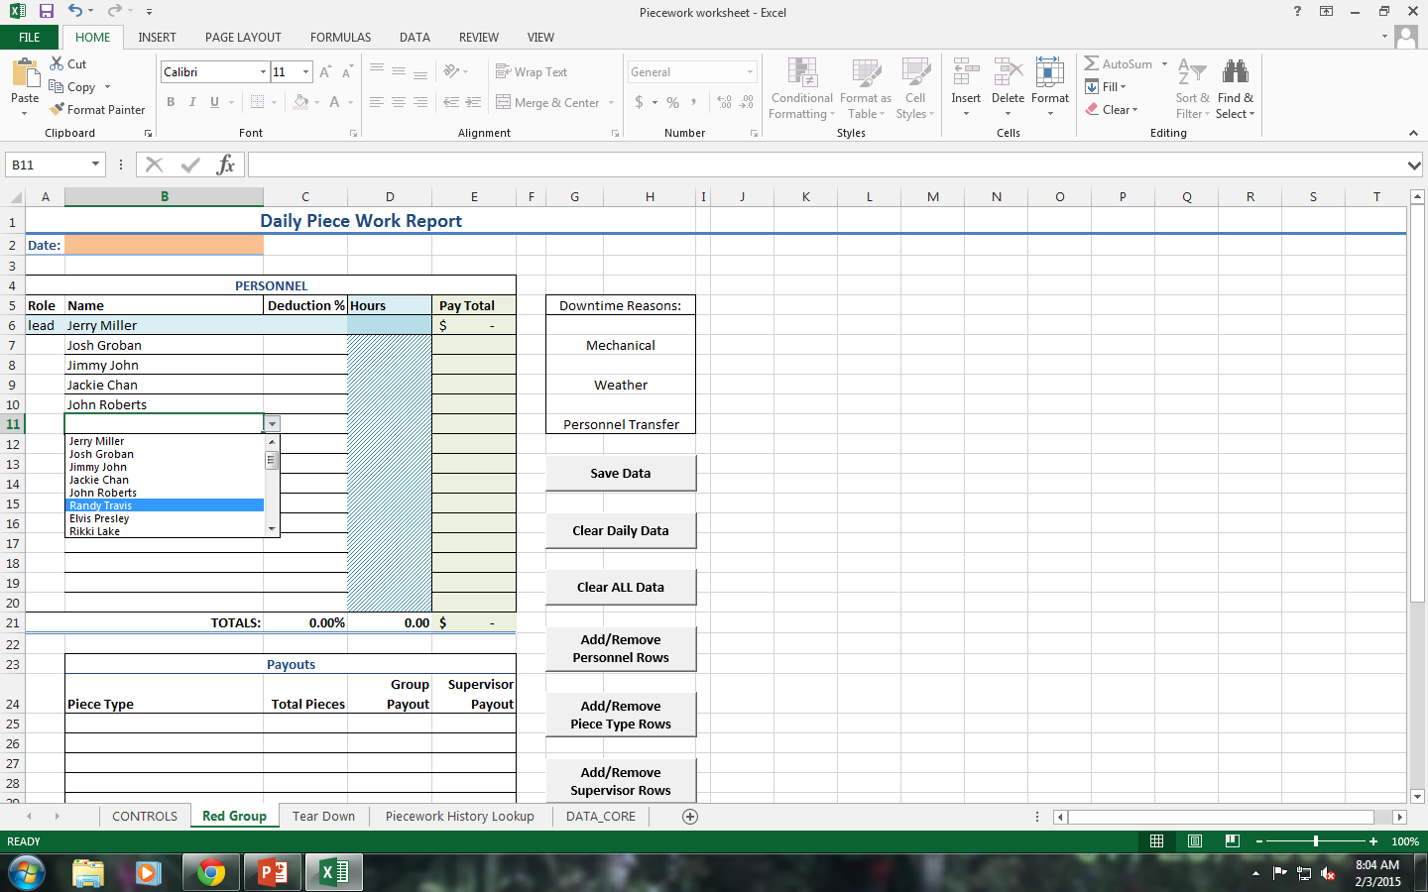
Employees added via drop down menu

Slide 9
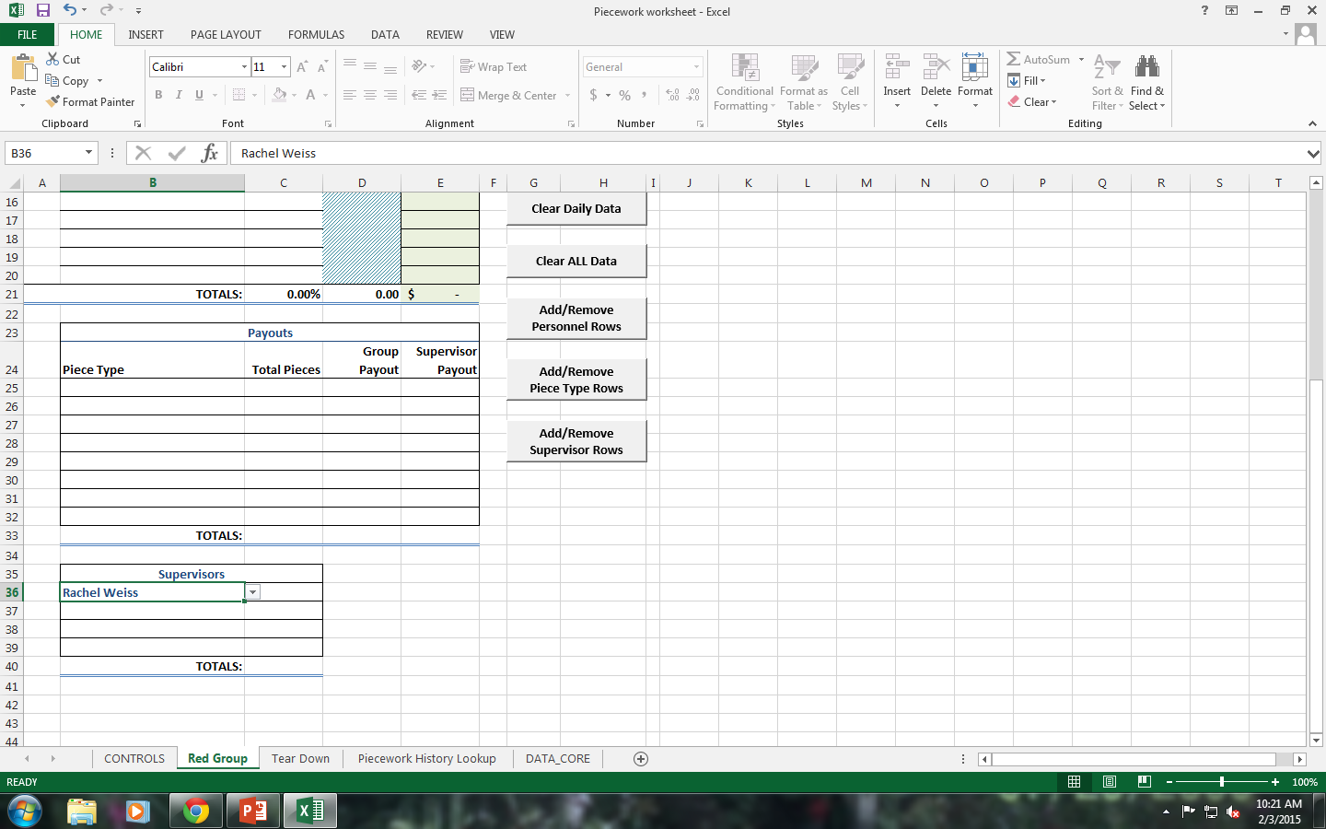
Supervisors added via drop down menu

Slide 10
Entering Pieces and hours
After the groups are created we can plug in the pieces they worked on.
As pieces and quantities are added, the program auto-calculates Piece payout based on core data settings
A date is required for each group.
After daily data is calculated you can print out the worksheets to be turned in to payroll.

Slide 11
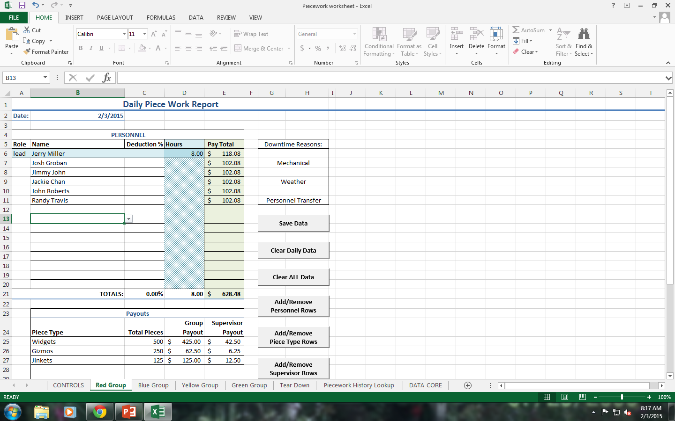
Examples (Top Half of page)

Slide 12
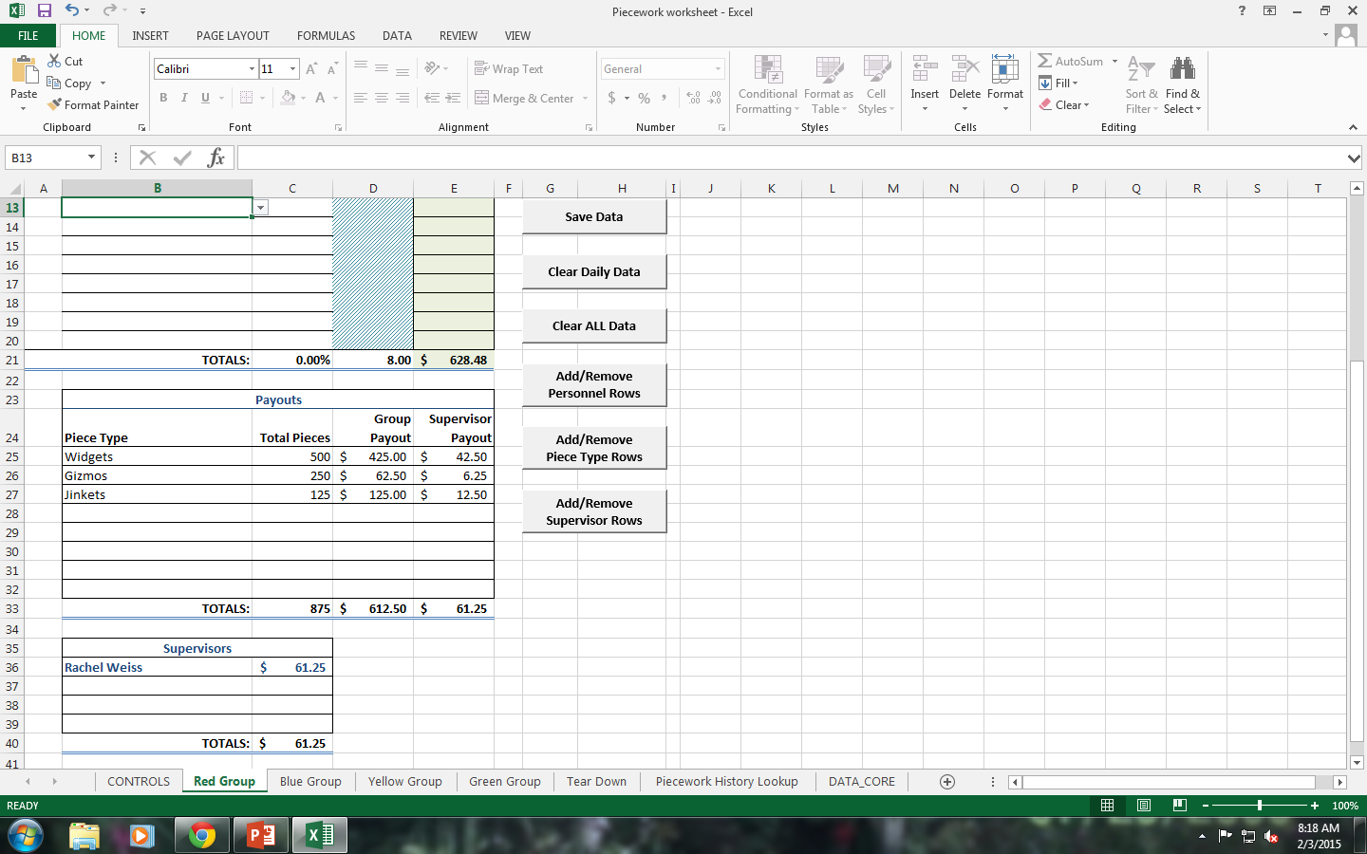
Bottom half of same Page

Slide 13
Deductions for arriving late or leaving early
There is a column in each group worksheet for percentage deductions.
If an Employee within a group arrives an hour late you can deduct 10% of that person’s payout.
A lead person or forklift driver who receives a small hourly wage in addition to the piece rate payout will only have the piece rate portion deducted using the % deduction column. The hourly rate will be reduced by putting in actual hours worked.

Slide 14
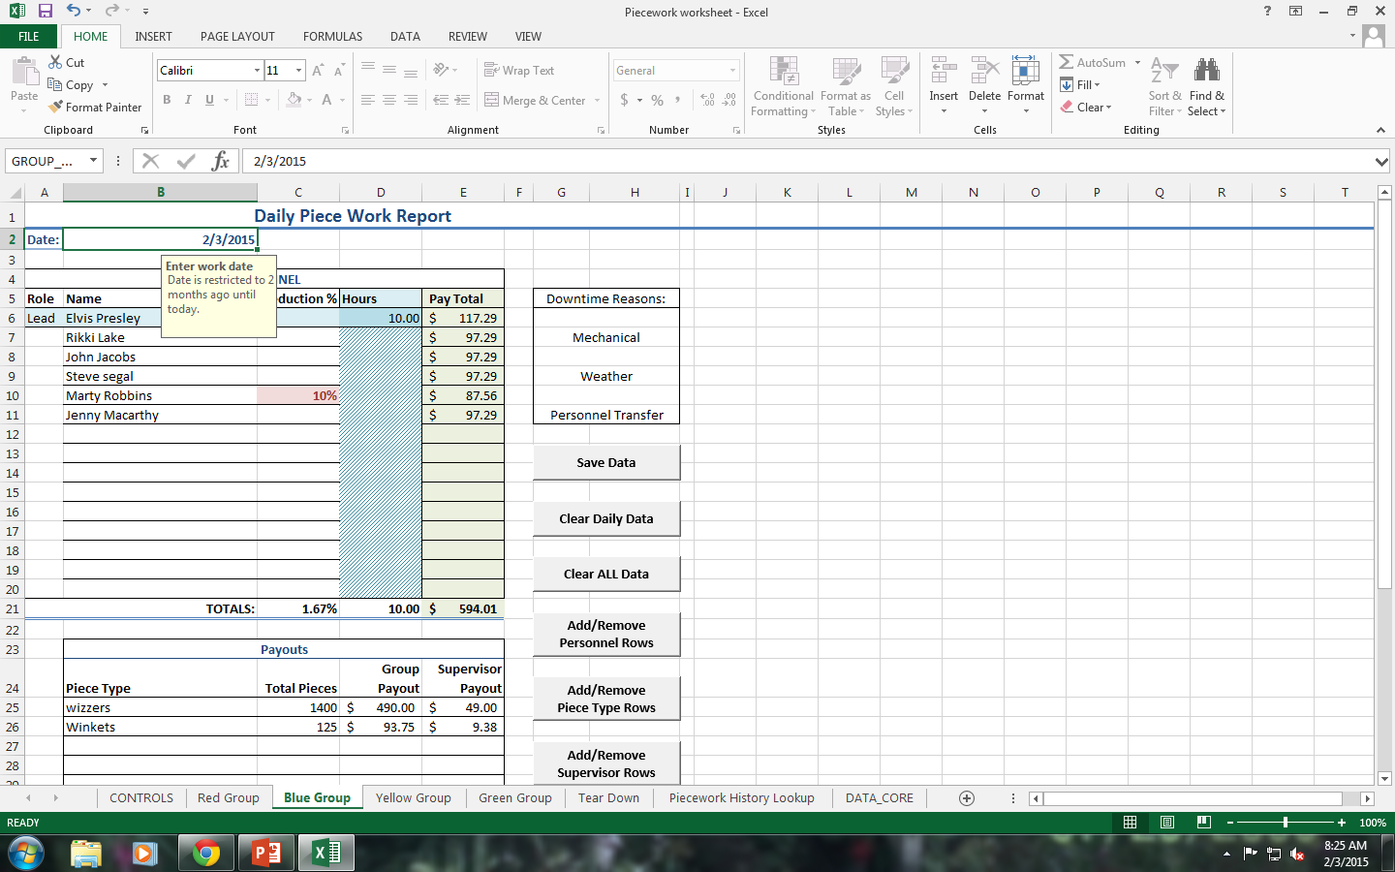
Deductions

Slide 15
Tear Down (Individual Piece Rate)
The tear down tab is basically the classic Individual Piece Rate
Bob produces 100 widgets at $1.00 each for a total of $100 today.
Like the group sheets, this sheet can be printed, saved to history and cleared at the end of each day.

Slide 16
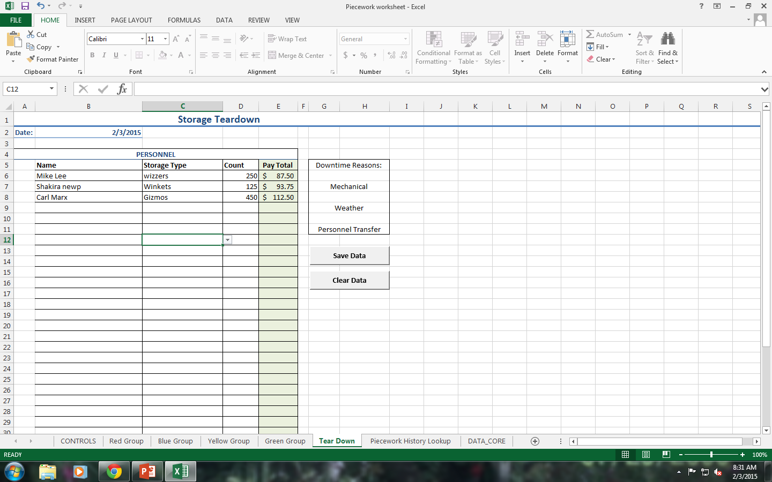

Slide 17
Saving and clearing daily data
After the daily data has been entered and printed you have the option to save the daily data.
When you click on save data the information is stored in a history file for future reference, analyzing, and searching.
Once data is saved you have the option to clear the daily data which wipes out the pieces and payout amounts but leaves employees intact within each group.
Clearing ‘all data’ removes all pieces, payout amounts and employees from the group in case you plan to add all new people.

Slide 18
History Data
As daily data is saved it is stored in a History file for viewing and analyzing
Click on the Control tab and then click ‘show history worksheet’
This will bring you directly to the History worksheet
There are several rows and columns of data with filters for analyzing all labor costs.

Slide 19
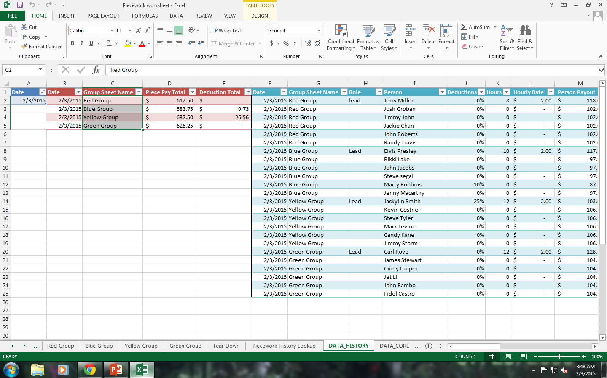

Slide 20
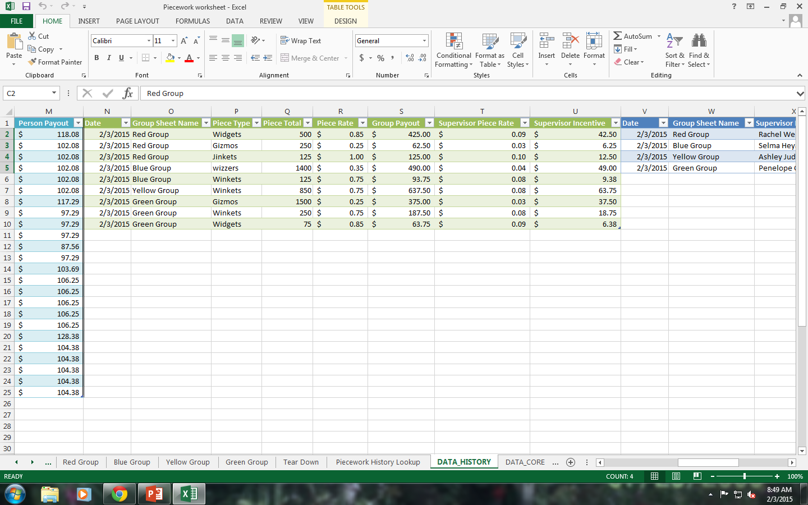

Slide 21
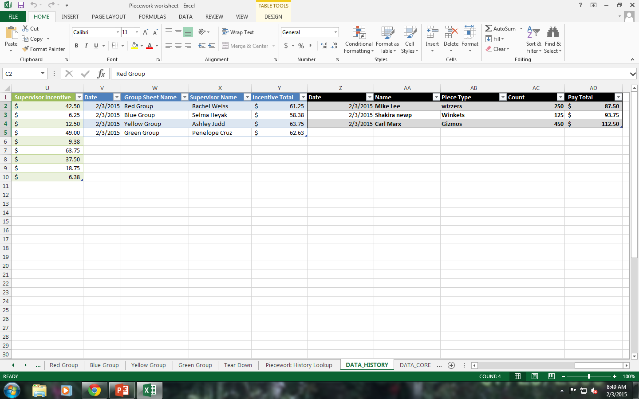

Slide 22
Piecework History Lookup
This tab allows you to look up what a group did on a particular day.
Choose a date and a group (Required)
A duplicate of the worksheet you created that day will be re-created to view or print.

Slide 23
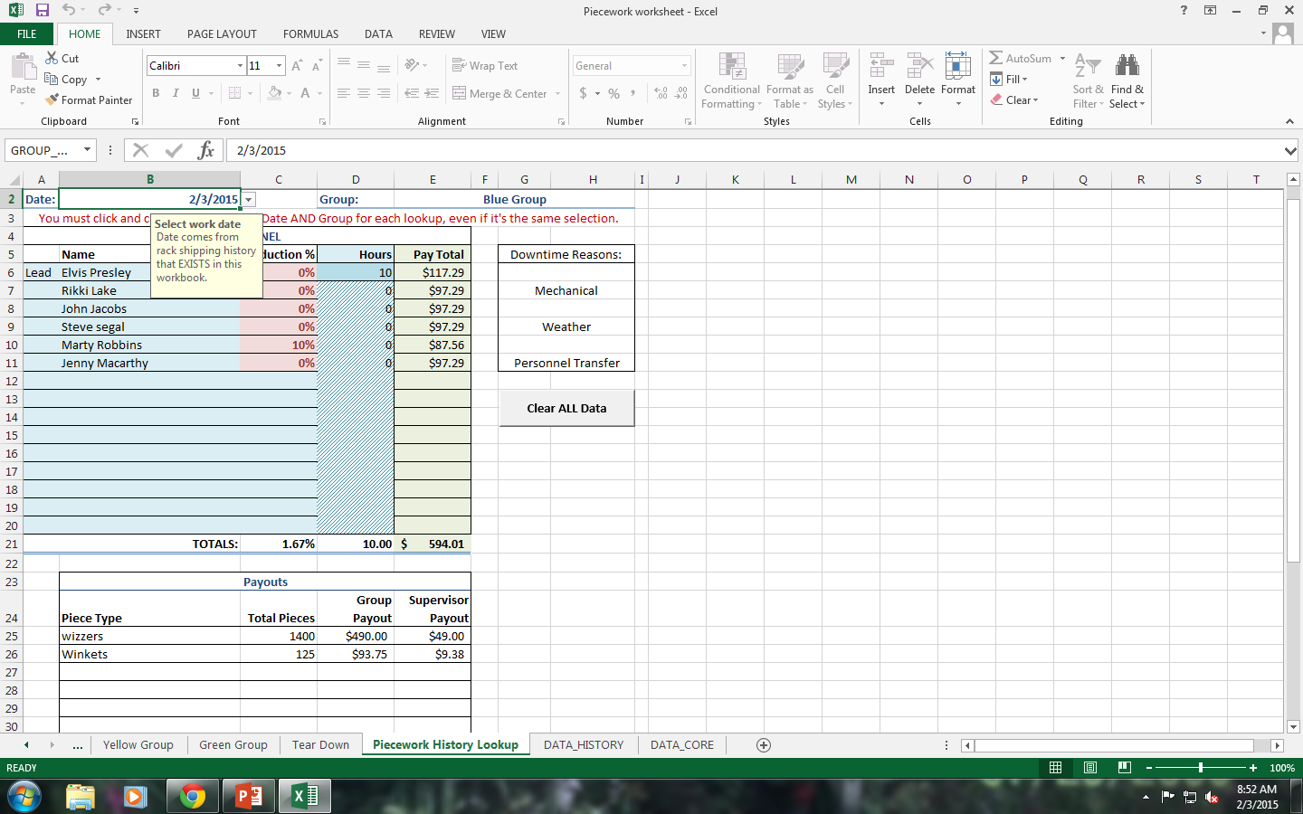

Slide 24
Step by Step Tutorial
A step by step tutorial link has been added to the program help file to help walk you through the initial set-up of the program, request enhancements, and fix any bugs you may encounter along the way.
This program was initially created to have several small groups at a large flower nursery work together as teams to gather plants, add tags and put the plants on rolling carts. The groups were paid by the truckload.
I have since left the Nursery and made some modifications to the program to make it more generic for general use in other companies.

Slide 25
A worthy Cause
10% of all proceeds from this program will be donated to Operation Underground Railroad https://www.ourrescue.org/
This is a group of former police officers and special forces Agents that rescue children from child sex trafficking.
I cannot think of a more horrific crime than trafficking children as sex slaves and in forced prostitution!

Slide 26


Slide 27


Slide 28


